Slide 1


JavaScript Basics
Variables
Operators
Types

Slide 2

JavaScript often abbreviated JS, is a programming language
that is one of the core technologies of the World Wide Web,
alongside HTML and CSS.
As of 2022, 98% of websites use JavaScript on the client
side for webpage behavior, often incorporating third-party libraries.
All major web browsers have a dedicated JavaScript engine
to execute the code on users' devices.
JavaScript was invented by Brendan Eich in 1995. It was developed for Netscape 2,
and became the ECMA-262 standard in 1997.
Today, JavaScript can execute not only in the browser, but also on the server, or actually on any device that has a special program called the JavaScript engine.

Slide 3
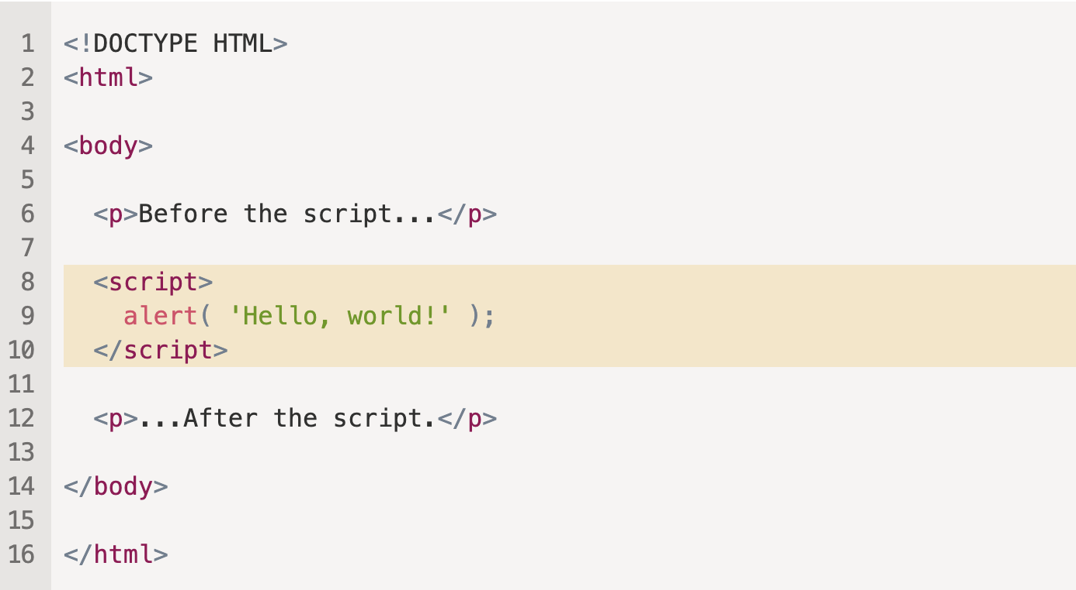
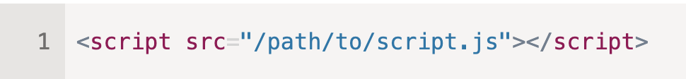
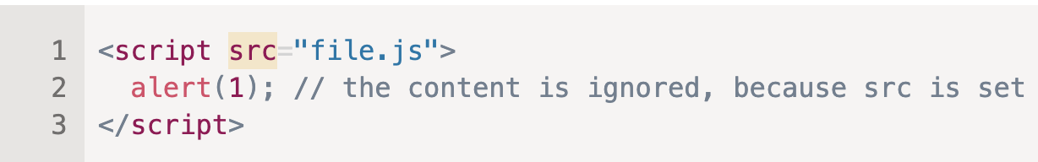

Slide 4


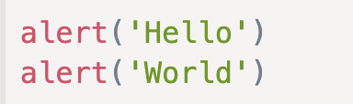
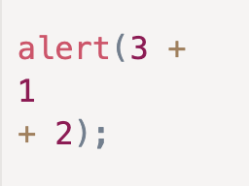
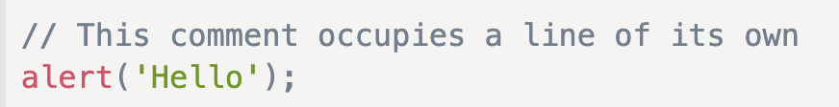
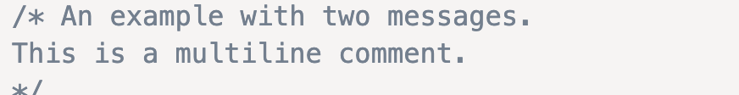
Code Structure
Statements are syntax constructs and commands that perform actions.
Usually, statements are written on separate lines to make the code more readable:
A semicolon may be omitted in most cases when a line break exists.
There are cases when a newline does not mean a semicolon. For example:
Comments

Slide 5
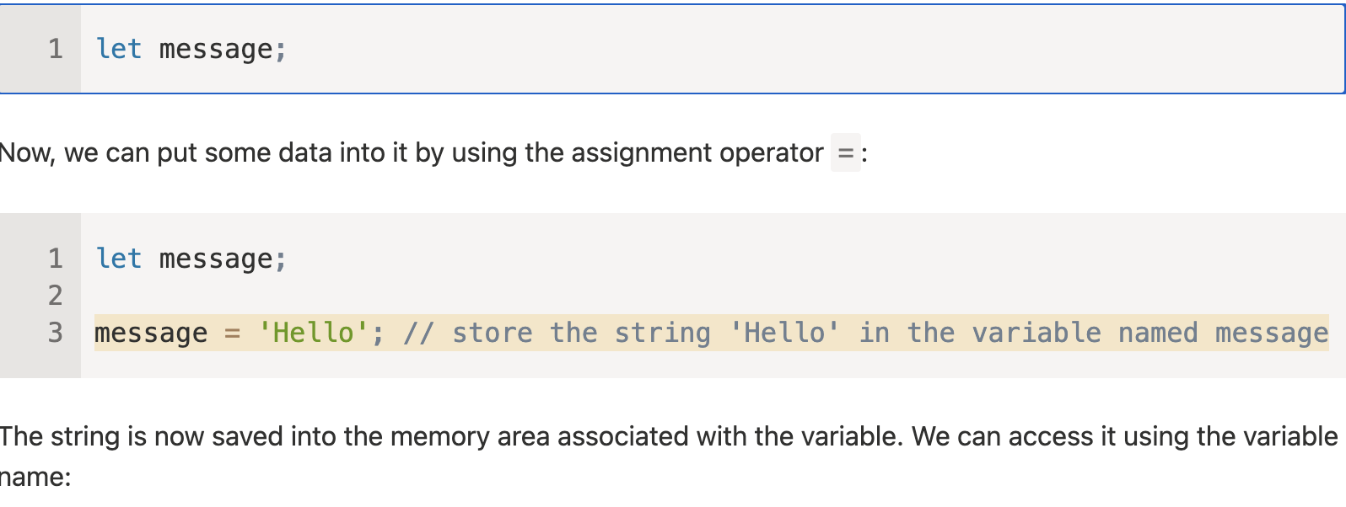

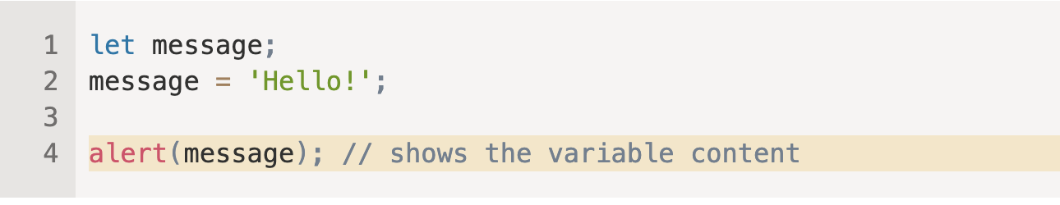
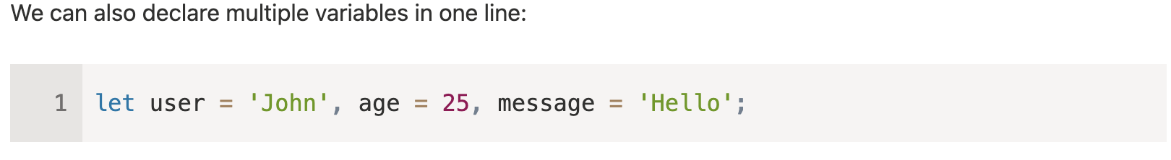
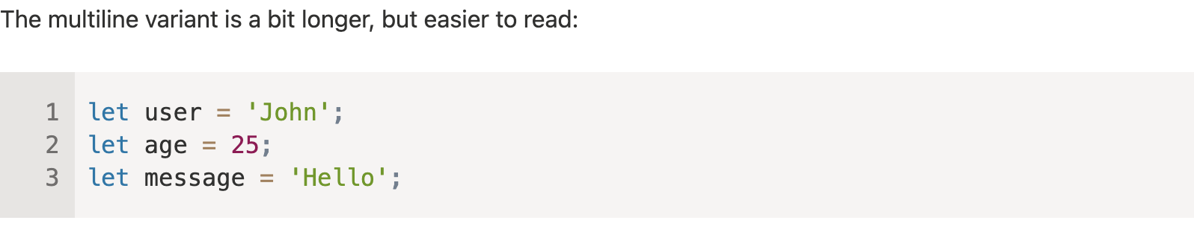
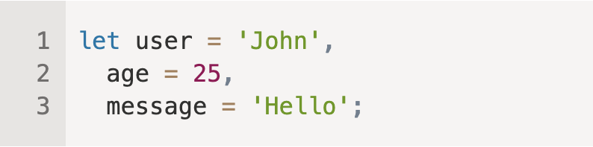
Variables

Slide 6
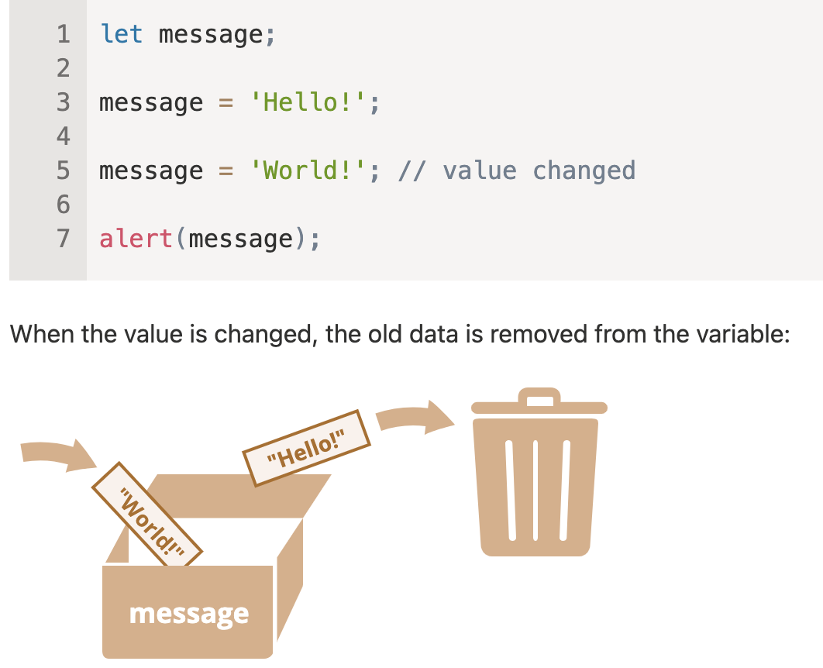
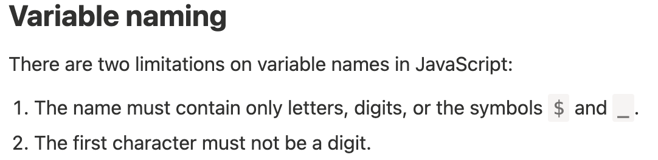


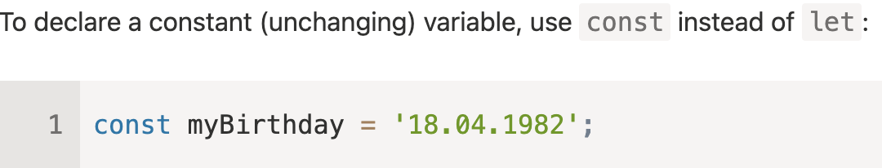
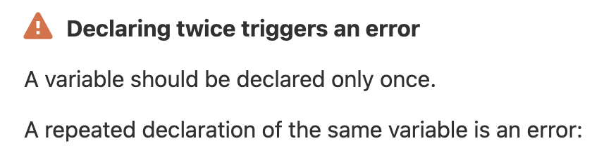
Variables

Slide 7
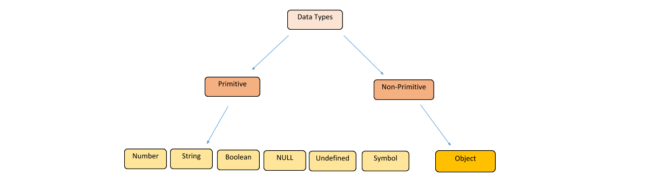
Data Types

Slide 8
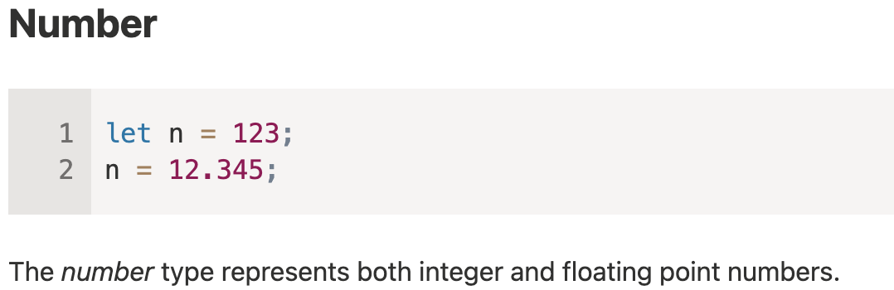
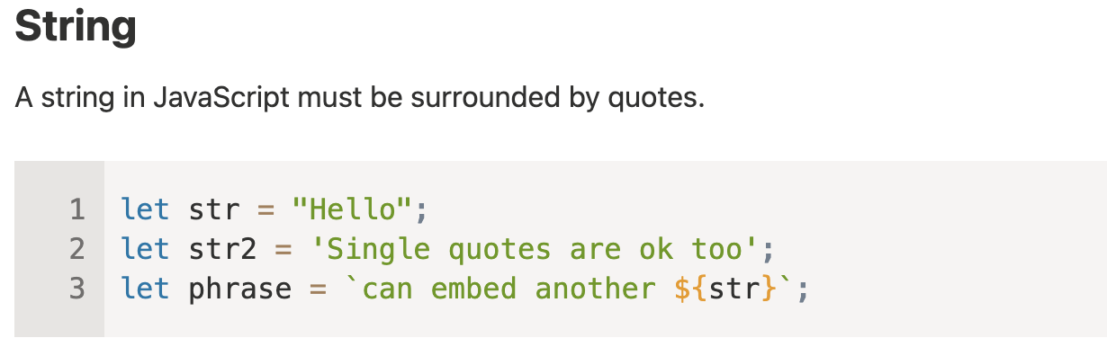

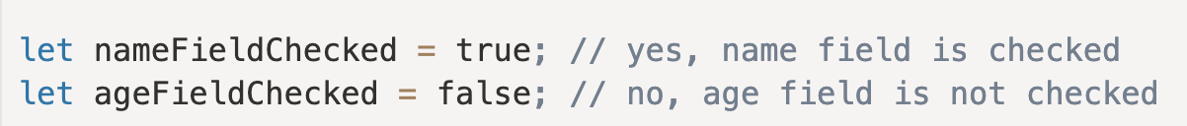
Data Types

Slide 9
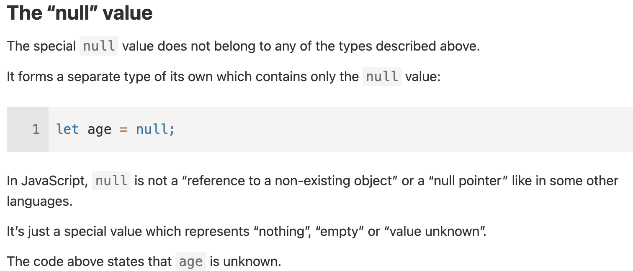
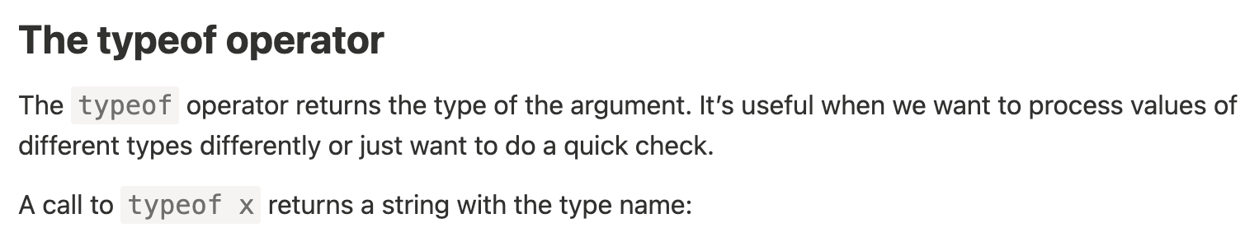
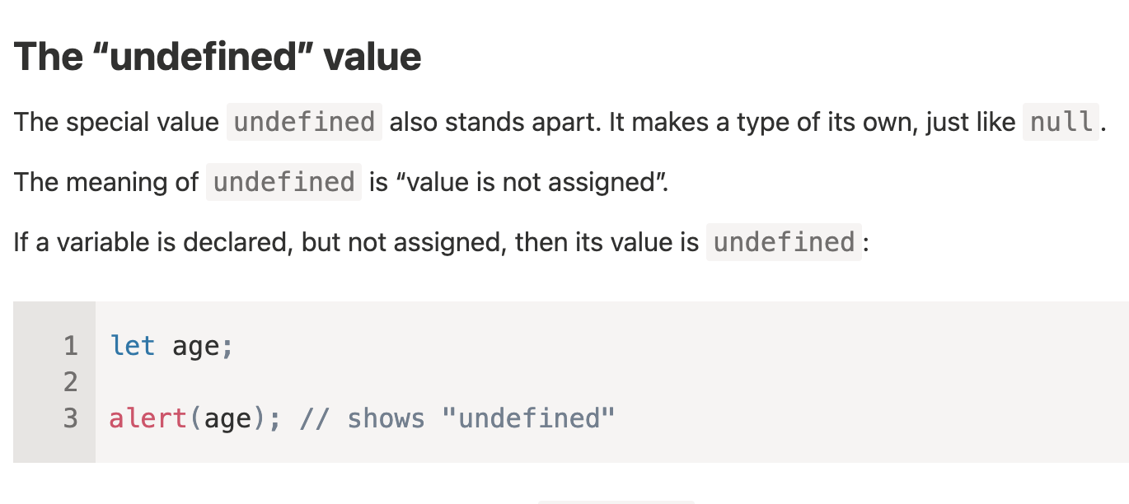
Data Types

Slide 10
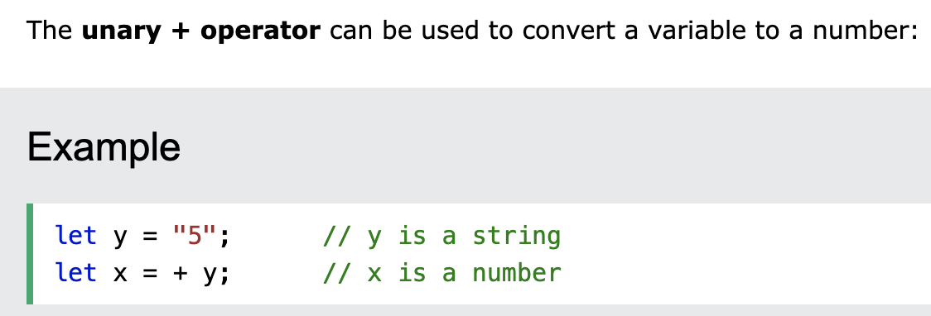
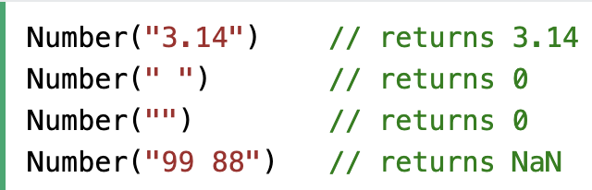
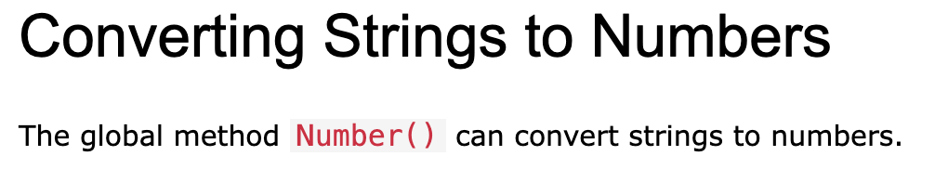
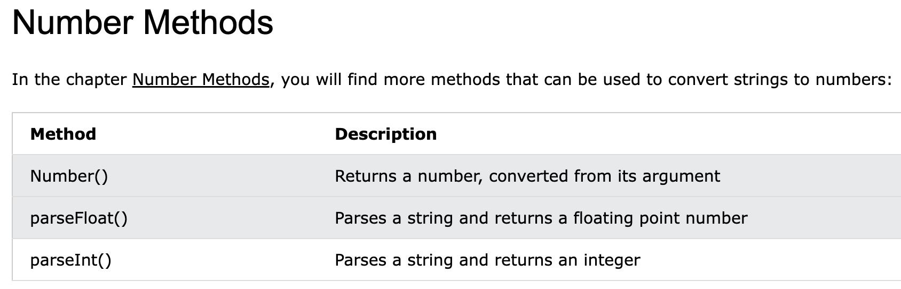

Type Conversion

Slide 11
Tasks
Create 2 variables name, age with values
Reassign Values
Show changed values using alert() function

Slide 12
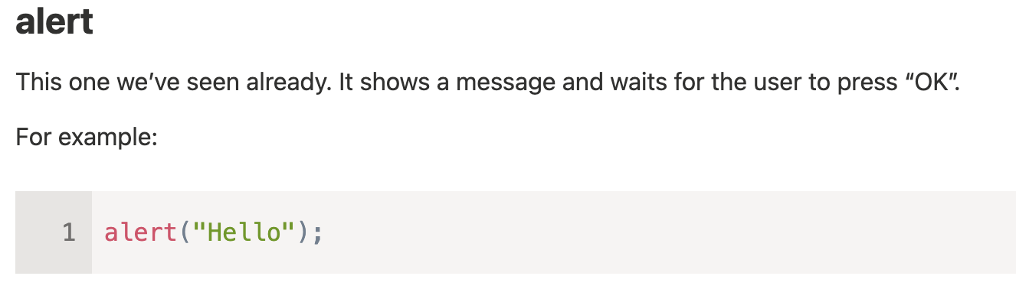
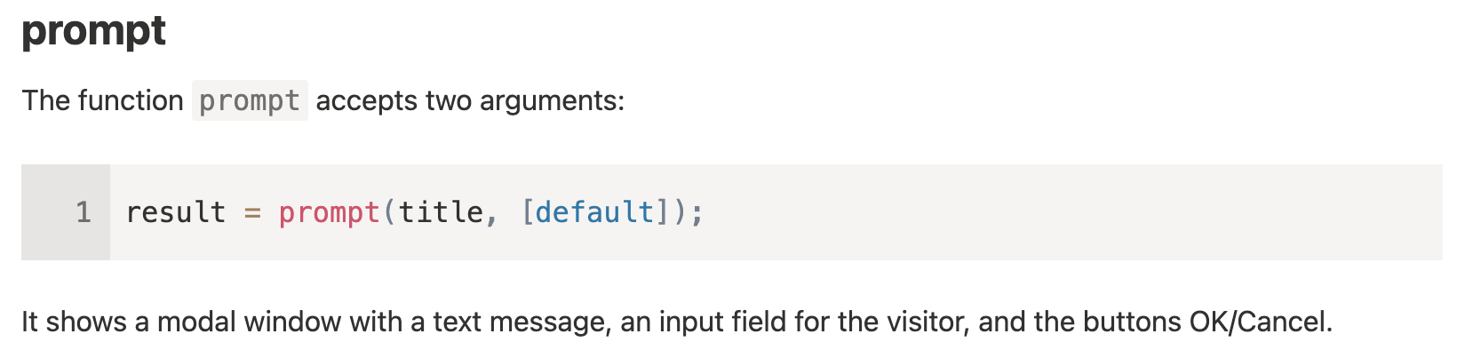
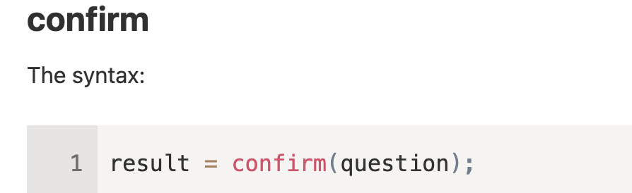
Interaction: alert, prompt, confirm

Slide 13
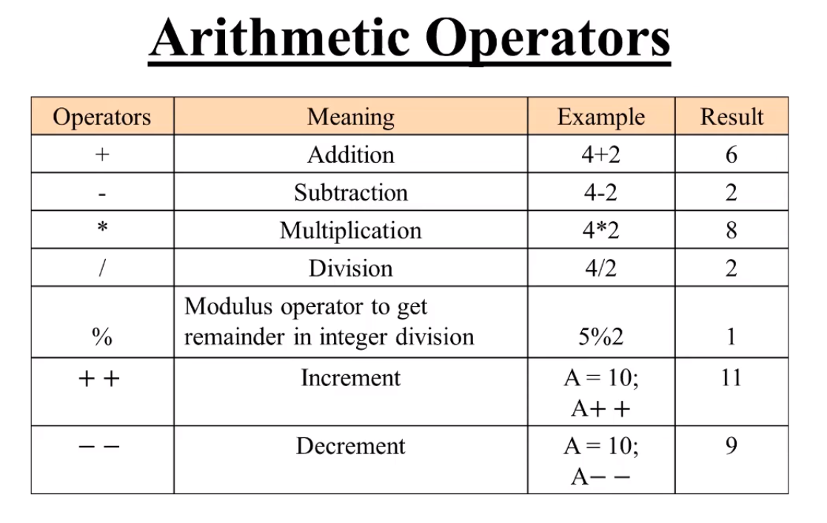
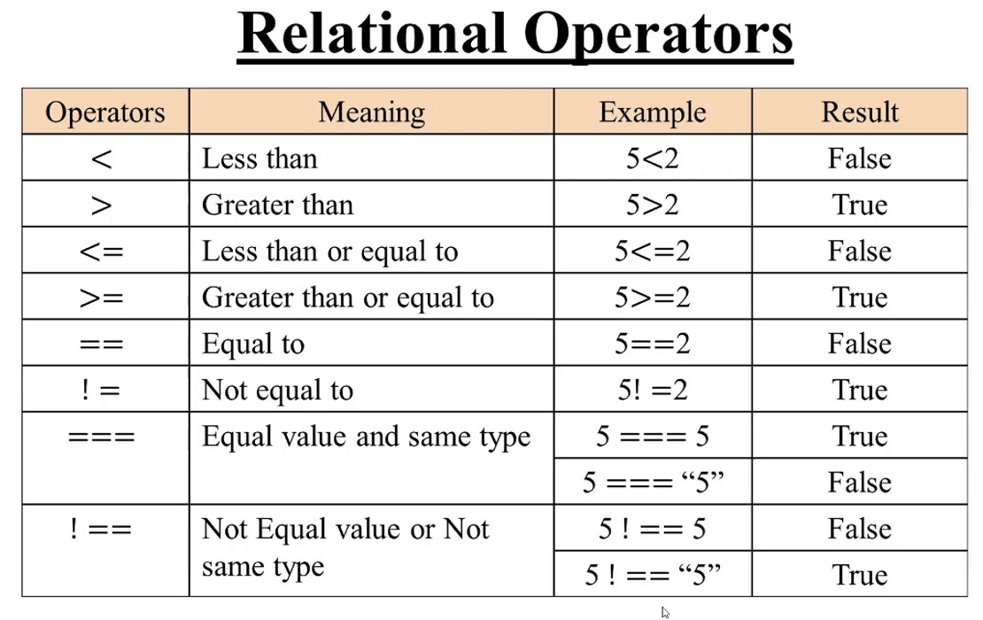
Basic operators
**
Exponentiation
2**3 8

Slide 14
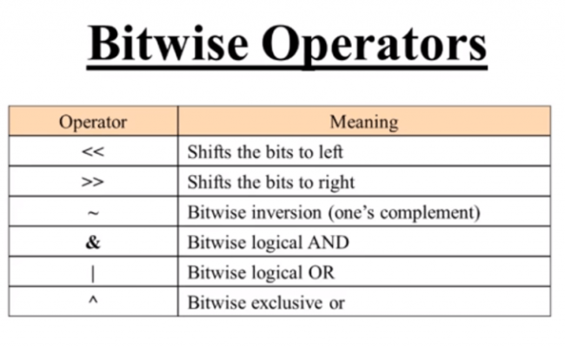
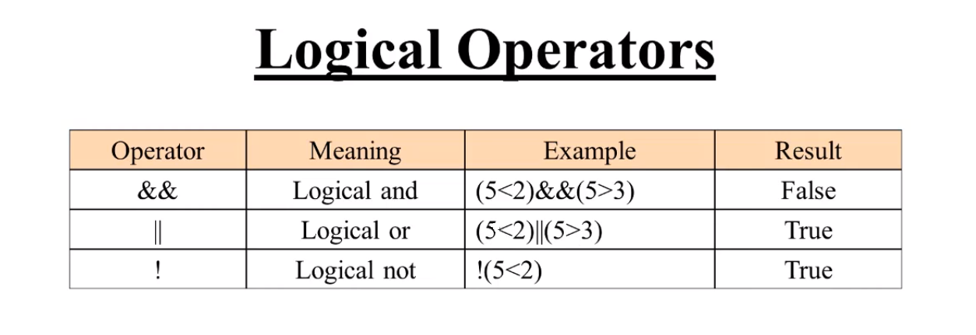
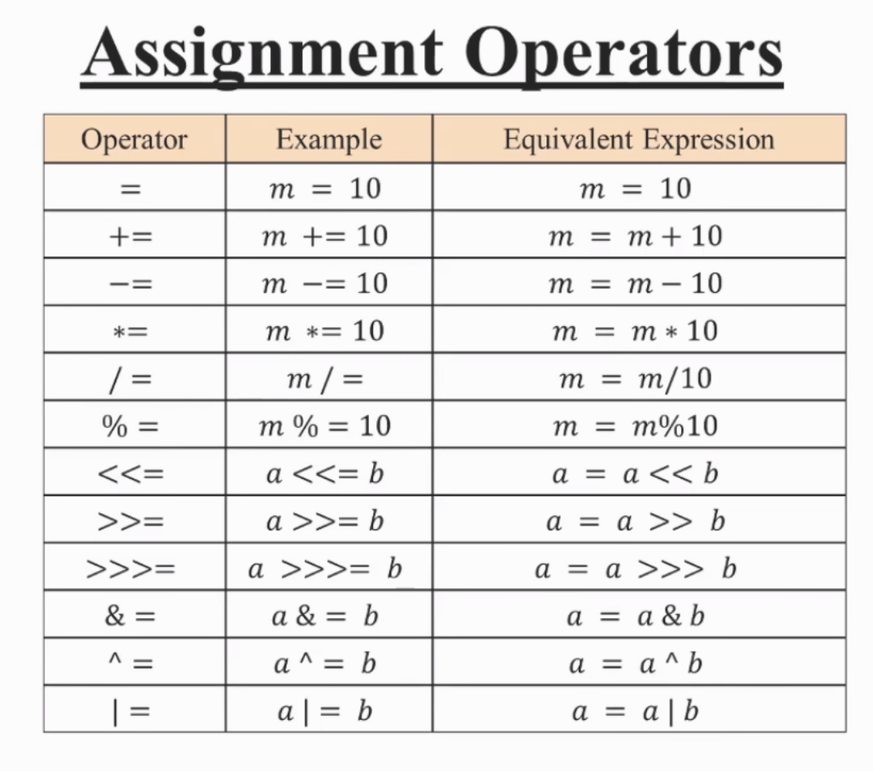

Slide 15
Tasks
Create prompt for getting user name and log it.
Create prompt for user age and if age is bigger than 18 log true else log false
Create x,y variables and use all operators (+,-, *, **…..)
Create x,y variables and swap them without using 3th variable.
Calculate and log areas of square, triangle, rectangle ,circle

